Slide 1
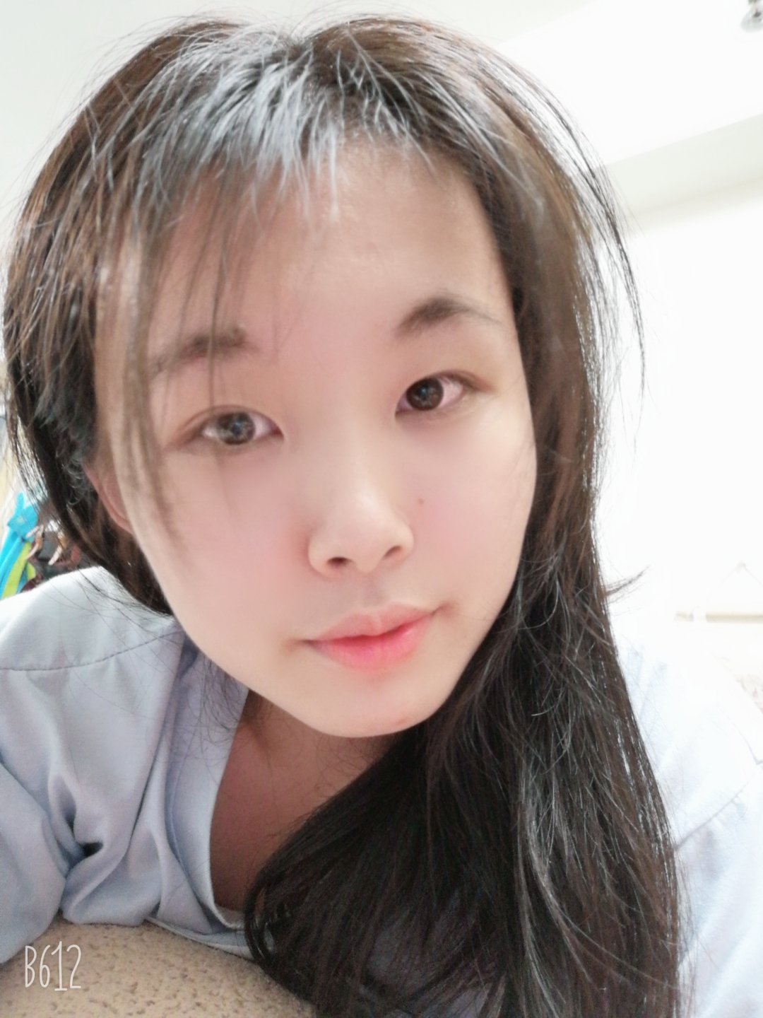
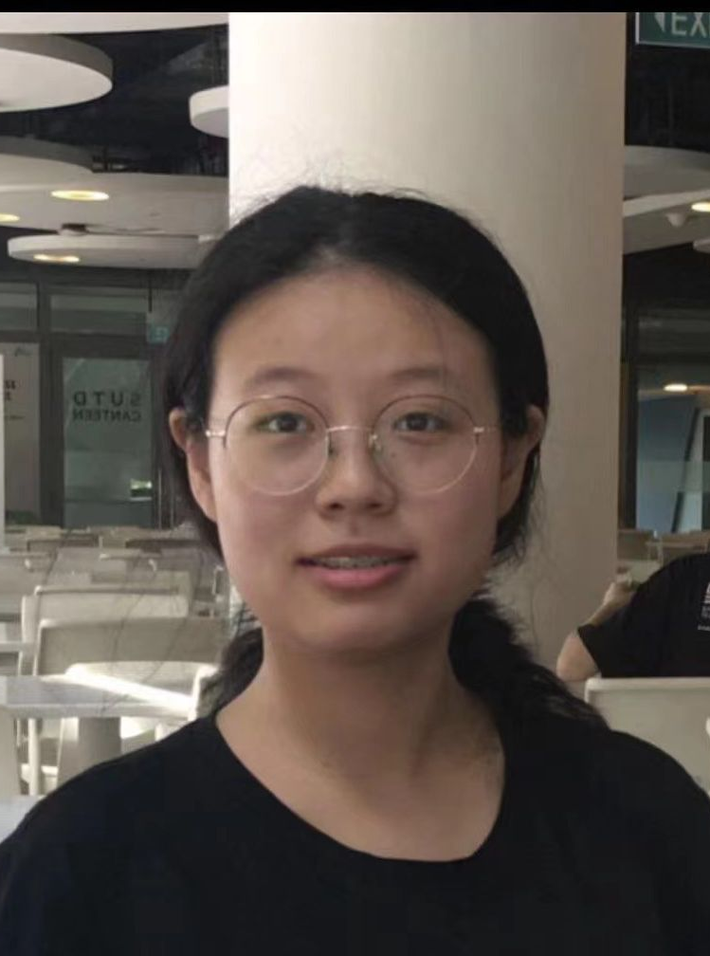
Grab Food Simulation with Different Region Size
Team 24
12/2021 Term 6
40.015 Simulation Modeling and Analysis
Cui Wenqi 1004523
Wu Xinyun 1004536

